Slide 1
Dynamic Programming

Slide 2
Dynamic Programming
Dynamic programming is a technique that breaks the problems into sub-problems, and saves the result for future purposes so that we do not need to compute the result again.
Dynamic Programming is a technique in computer programming that helps to efficiently solve a class of problems that have overlapping sub problems and optimal substructure property.

Slide 3
Dynamic Programming
Let us assume that we have a complex question and we always think of a solution that divides the question into subproblems.
But we may get stuck in a situation where we will compute a subproblem multiple times.
There we use dynamic programming for an optimal solution.

Slide 4
Dynamic Programming
Dynamic Programming is mainly used when solutions to the same subproblems are needed again and again.
In dynamic programming, computed solutions to subproblems are stored in a table so that these don’t have to be recomputed.
So Dynamic Programming is not useful when there are no common (overlapping) subproblems because there is no point in storing the solutions if they are not needed again.
For example, Binary Search doesn’t have common subproblems

Slide 5
Dynamic Programming
Let's understand the concept of overlapping subproblem through an example.
Consider an example of the Fibonacci series.
The following series is the Fibonacci series: 0, 1, 1, 2, 3, 5, 8, 13, 21, 34, 55,…
The numbers in the above series are not randomly calculated. Mathematically, we could write each of the terms using the below formula:
F(n) = F(n-1) + F(n-2),
With the base values F(0) = 0, and F(1) = 1. To calculate the other numbers, we follow the above relationship.
For example, F(2) is the sum f(0) and f(1), which is equal to 1.

Slide 6
Dynamic Programming
We have two methods to deal with this (i) memoization, (ii)tabulation
1. Memoization:
The solution to the given problem is to save the computed results in an array.
First, we calculate F(16) and F(17) and save their values in an array.
The F(18) is calculated by summing the values of F(17) and F(16), which are already saved in an array. The computed value of F(18) is saved in an array.
The value of F(19) is calculated using the sum of F(18), and F(17), and their values are already saved in an array. The computed value of F(19) is stored in an array.
The value of F(20) can be calculated by adding the values of F(19) and F(18), and the values of both F(19) and F(18) are stored in an array.
The final computed value of F(20) is stored in an array.

Slide 7
Dynamic Programming
When the value of 'n' increases, the function calls will also increase, and computations will also increase. In this case, the time complexity increases exponentially, and it becomes 2^{n}.
One solution to this problem is to use the dynamic programming approach. Rather than generating the recursive tree again and again, we can reuse the previously calculated value. If we use the dynamic programming approach, then the time complexity would be O(n).

Slide 8
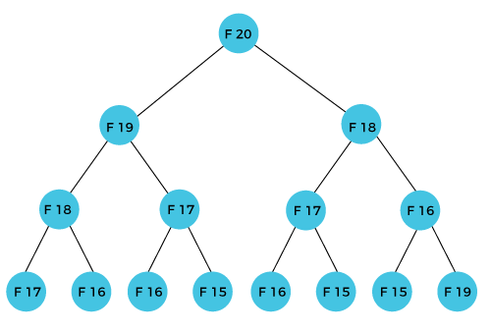
Dynamic Programming
How can we calculate F(20)?
The F(20) term will be calculated using the nth formula of the Fibonacci series. The below figure shows that how F(20) is calculated.
As we can observe in the above figure that F(20) is calculated as the sum of F(19) and F(18). In the dynamic programming approach, we try to divide the problem into the similar subproblems. We are following this approach in the above case where F(20) into the similar subproblems, i.e., F(19) and F(18). If we recap the definition of dynamic programming that it says the similar subproblem should not be computed more than once.

Slide 9
Dynamic Programming
Still, in the above case, the subproblem is calculated twice. In the above example, F(18) is calculated two times; similarly, F(17) is also calculated twice. However, this technique is quite useful as it solves the similar subproblems, but we need to be cautious while storing the results because we are not particular about storing the result that we have computed once, then it can lead to a wastage of resources.
In the above example, if we calculate the F(18) in the right subtree, then it leads to the tremendous usage of resources and decreases the overall performance.

Slide 10
Dynamic Programming
2. Tabulation
This method is a little different than the above solution. Memoization follows the same recursive solution.
But in tabulation, we follow an iterative solution. It is also called the bottom-up approach.
As we know that F(n)= F(n-1) + F(n-2), In memoization we started with F(20) function call, and then we realized that we haven’t computed its value, so we’ve computed its values and then stored it.
A similar situation will be faced by further recursive calls like F(19), F(18). Now that makes a lot of recursive calls wait in the recursion stack, but anyways we are skipping the duplication of the overlapping subproblems.

Slide 11
Dynamic Programming
Optimal Substructure
In this concept, we can obtain an optimal solution to a problem only if we have optimally solved its corresponding subproblems.
Example of this concept is considering a traversal between nodes in a graph.
Let us assume that we have multiple roots from Telangana to Delhi. And if we have the shortest route which passes through Nagpur and Gwalior. Then the shortest route from Nagpur to Delhi. Delhi must pass through Gwalior. Now we can split our problem into subproblems which are Telangana to Nagpur, Nagpur to Gwalior, Gwalior to Delhi.

Slide 12
How does dynamic approach works
The following are the steps that the dynamic programming follows:
It breaks down the complex problem into simpler subproblems.
It finds the optimal solution to these sub-problems.
It stores the results of subproblems.
It reuses them so that same sub-problem is calculated more than once.
Finally, calculate the result of the complex problem.

Slide 13
Recursion vs Dynamic Programming
Dynamic programming is mostly applied to recursive algorithms. Most optimization problems require recursion and dynamic programming is used for optimization.
But not all problems that use recursion can use Dynamic Programming. Unless there is a presence of overlapping subproblems like in the Fibonacci sequence problem, a recursion can only reach the solution using a divide and conquer approach.
That is the reason why a recursive algorithm like Merge Sort cannot use Dynamic Programming, because the subproblems are not overlapping in any way.

Slide 14
Greedy vs Dynamic Programming
Greedy Algorithms are similar to dynamic programming in the sense that they are both tools for optimization.
However, greedy algorithms look for locally optimum solutions or in other words, a greedy choice, in the hopes of finding a global optimum. Hence greedy algorithms can make a guess that looks optimum at the time but becomes costly down the line and do not guarantee a globally optimum.
Dynamic programming, on the other hand, finds the optimal solution to subproblems and then makes an informed choice to combine the results of those subproblems to find the most optimum solution.

Slide 15
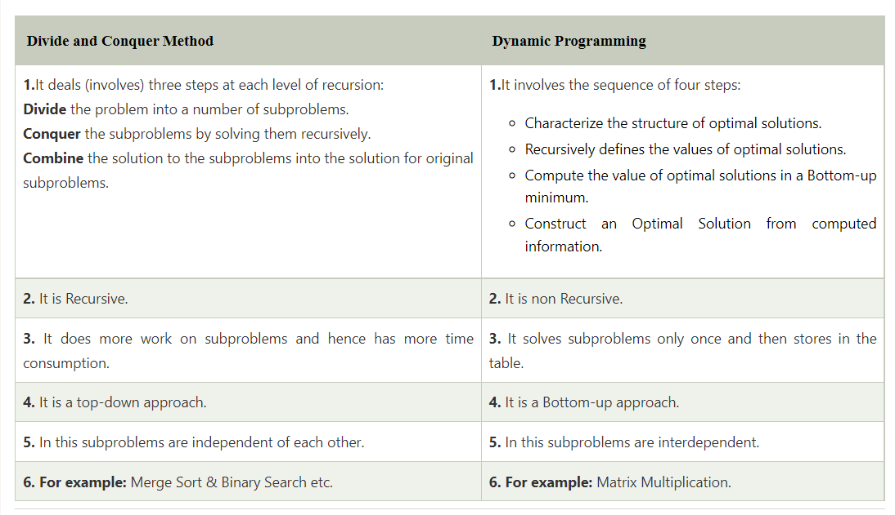
Divide and Conquer vs Dynamic Programming

Slide 16
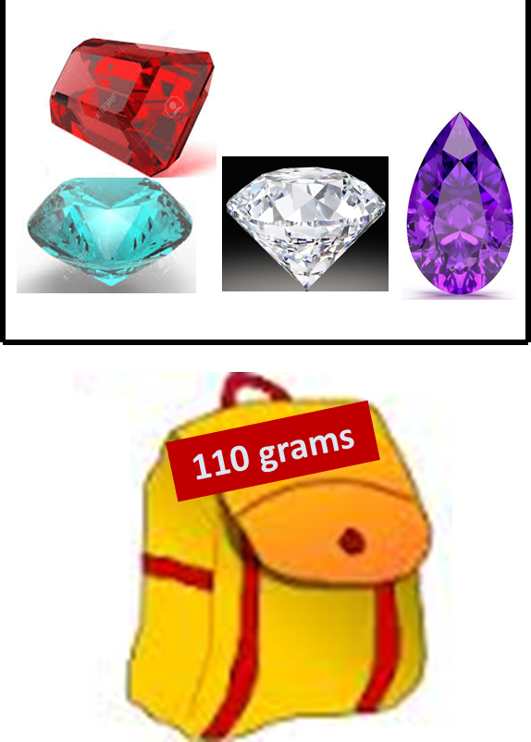
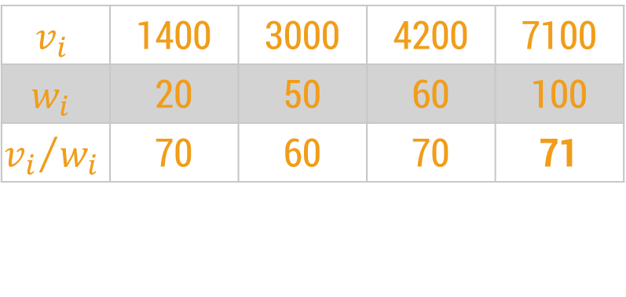
A box contains 4 stones worth $1400, $3000, $4200 and $7100. They weigh 20, 50, 60 and 100 grams respectively.
Your bag can only hold 110 grams.
Greedy Approach
The greedy algorithm selects the best candidate with the highest profit, i.e., stone worth $7100.
$$v_{i}$$ | 1400 | 3000 | 4200 | 7100
$$w_{i}$$ | 20 | 50 | 60 | 100
$${v_{i}}/{w_{i}}$$ | 70 | 60 | 70 | 71

Slide 17
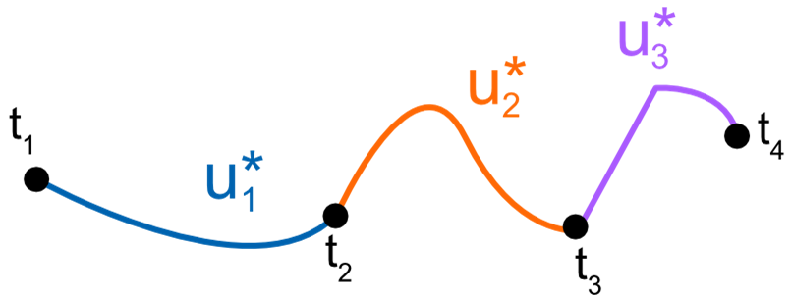
The Principle of Optimality
A dynamic-programming algorithm solves every sub-problem just once and then saves its answer in a table.
It avoids the work of re-computing the answer every time the sub problem is encountered.
The dynamic programming algorithm obtains the solution using principle of optimality.
The principle of optimality states that “in an optimal sequence of decisions or choices, each subsequence must also be optimal.
If it is not possible to apply the principle of optimality then it is almost impossible to obtain the solution using the dynamic programming approach.

Slide 18
Binomial Coefficient

Slide 19
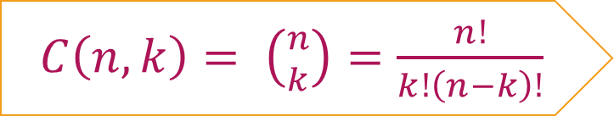
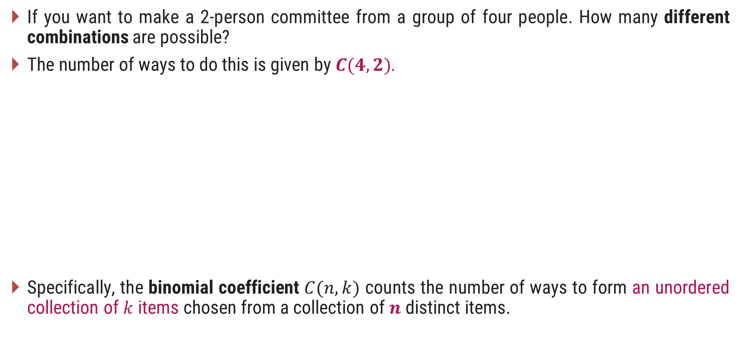
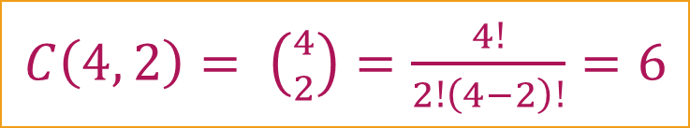
Introduction
If you want to make a 2-person committee from a group of four people. How many different combinations are possible?
The number of ways to do this is given by $C(4, 2)$.
Specifically, the binomial coefficient $C(n, k)$ counts the number of ways to form an unordered collection of $k$ items chosen from a collection of $n$ distinct items.
Consider 4 people A, B, C, D. Now the different combinations for making a committee of 2 persons from these 4 are;
A, B
A, C
A, D
C, D
B, D
B, C
$C\left(n,k\right)= \left({n \atop k}\right)=\frac{n!}{k!\left(n−k\right)!}$
$C\left(4, 2\right)= \left({4 \atop 2}\right)=\frac{4!}{2!\left(4−2\right)!}=6$

Slide 20
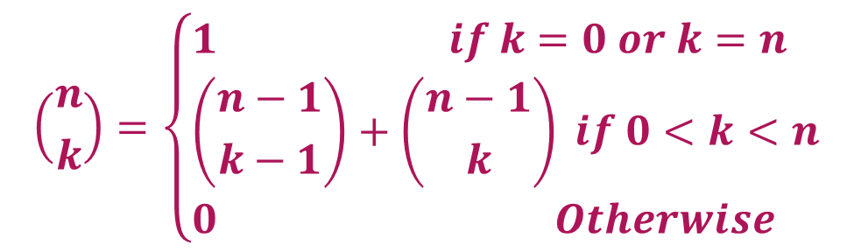
Binomial Coefficient
The definition of binomial coefficient is given as:
$$\left({n \atop k}\right)=\left\{\begin{aligned}&1 if k=0 or k=n \\ &\left({n−1 \atop k−1}\right)+\left({n−1 \atop k}\right) if 0<k<n \\ &0 Otherwise\end{aligned}\right)$$
function C(n, k)
if k=0 or k=n then return 1
else return C(n-1, k-1) + C(n-1, k)

Slide 21
Binomial Coefficient
 | 0 | 1 | 2 | 3 | 4 | 5 | .. | k
0 | 1
1 | 1 | 1
2 | 1 | 2 | 1
3 | 1 | 3 | 3 | 1
4 | 1 | 4 | 6 | 4 | 1
..
n
+
+
+
+
+
+
PASCAL’s TRIANGLE
function C(n, k)
if k=0 or k=n then return 1
else return C(n-1, k-1) + C(n-1, k)

Slide 22
Generalized Solution using Dynamic Programming
Characterize the structure of an optimal solution.
Recursively define the value of an optimal solution.
Compute the value of an optimal solution in a bottom-up fashion.
Construct an optimal solution from the computed information.

Slide 23
Making Change Problem

Slide 24
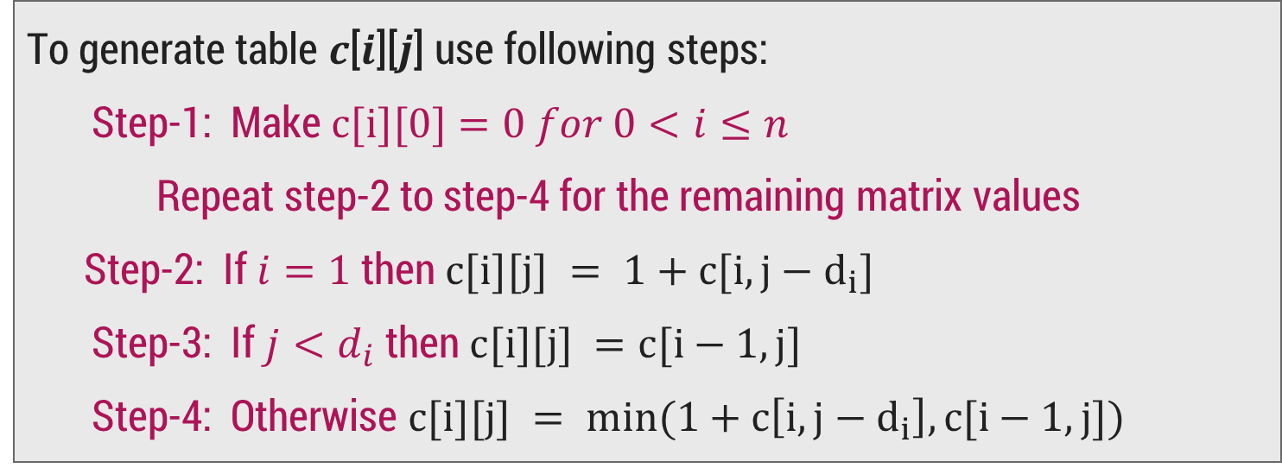
Making Change Problem
We need to generate a table 𝑐[𝑛][𝑁], where
𝑛 = number of denominations
𝑁= amount for which you need to make a change.
To generate table 𝒄[𝒊][𝒋] use following steps:
Step-1: Make $c[i][0]=0$𝑓𝑜𝑟 $0<i≤n$
Repeat step-2 to step-4 for the remaining matrix values
Step-2: If $i=1$then $c[i][j] = 1+c[i,j−d_{i}]$
Step-3: If $j<d_{i}$ then $c[i][j] =c[i−1,j]$
Step-4: Otherwise $c[i][j] = min⁡(1+c\left[i,j−d_{i}\right],c[i−1,j])$
Optimal
Sub-structure

Slide 25
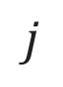
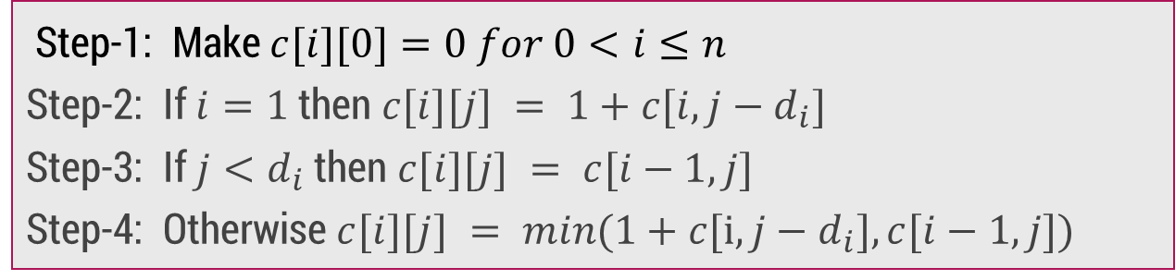
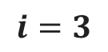
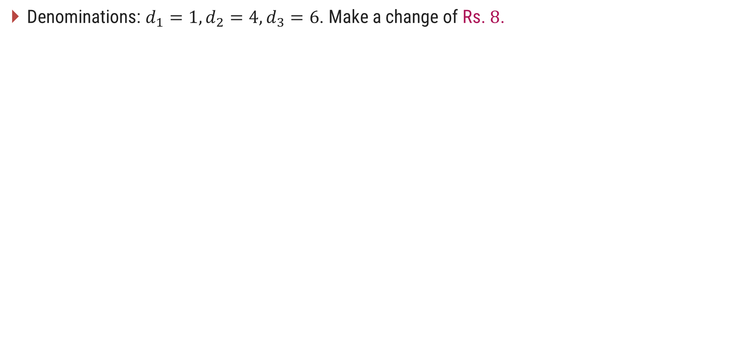
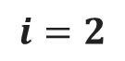
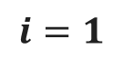
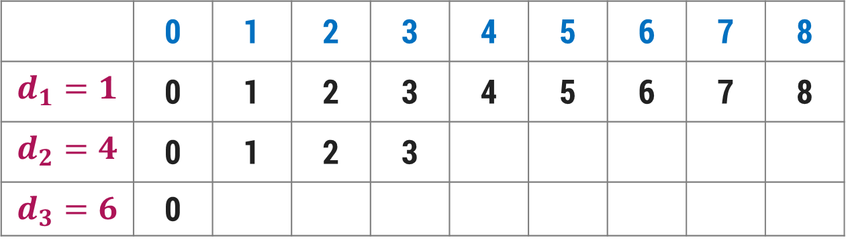
Making Change Problem
Denominations: $d_{1}=1, d_{2}=4, d_{3}=6$. Make a change of Rs. $8$.
Step-1: Make $c[i][0]=0 for 0<i≤n$
Step-2: If $i=1$then $c[i][j] = 1+c[i,j−d_{i}]$
Step-3: If $j<d_{i}$ then $c[i][j] = c[i−1,j]$
Step-4: Otherwise $c[i][j] = min(1+c[i,j−d_{i}],c[i−1,j])$
$$j$$
Amount
 | 0 | 1 | 2 | 3 | 4 | 5 | 6 | 7 | 8
$$d_{1}=1$$ | 0 | 1 | 2 | 3 | 4 | 5 | 6 | 7 | 8
$$d_{2}=4$$ | 0 | 1 | 2 | 3
$$d_{3}=6$$ | 0
$$i=1$$
$$i=2$$
1
2
$$i=3$$
$$min⁡(c[1][4],1+c[2][0])=min⁡(4,1+0)=min⁡(4,1)=1$$
$$min(c[1][5],1+c[2][1])=min(5,1+1)=min(5,2)=2$$

Slide 26
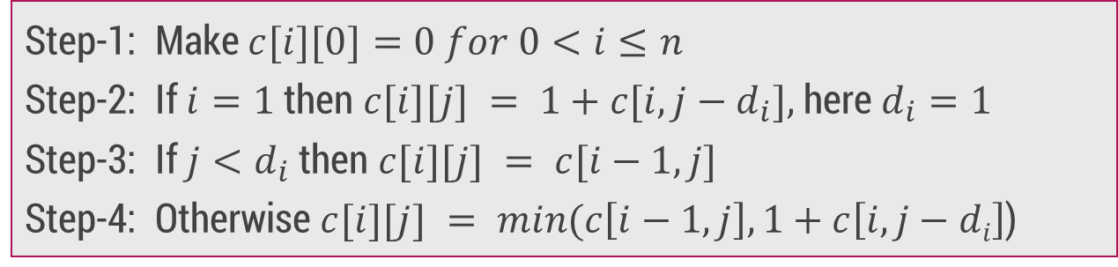
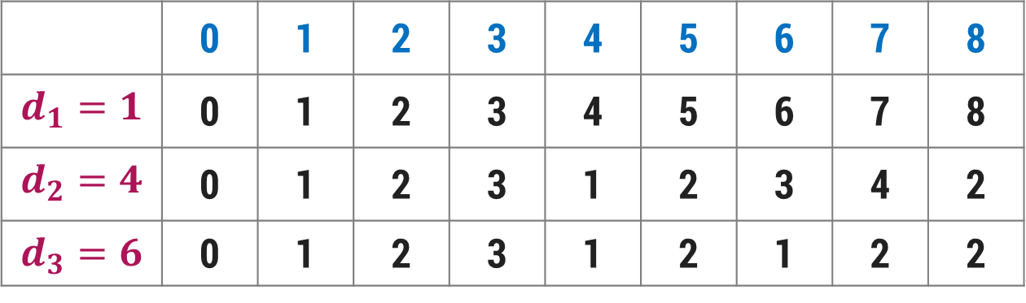
Making Change Problem
Denominations: $d_{1}=1, d_{2}=4, d_{3}=6$. Make a change of Rs. $8$.
Step-1: Make $c[i][0]=0 for 0<i≤n$
Step-2: If $i=1$then $c[i][j] = 1+c[i,j−d_{i}],$here $d_{i}=1$
Step-3: If $j<d_{i}$ then $c[i][j] = c[i−1,j]$
Step-4: Otherwise $c[i][j] = min(c\left[i−1,j\right],1+c\left[i,j−di\right]$)
$$j$$
Amount
 | 0 | 1 | 2 | 3 | 4 | 5 | 6 | 7 | 8
$$d_{1}=1$$ | 0 | 1 | 2 | 3 | 4 | 5 | 6 | 7 | 8
$$d_{2}=4$$ | 0 | 1 | 2 | 3 | 1 | 2 | 3 | 4 | 2
$$d_{3}=6$$ | 0 | 1 | 2 | 3 | 1 | 2 | 1 | 2 | 2
$$i=1$$
$$i=2$$
$$i=3$$

Slide 27
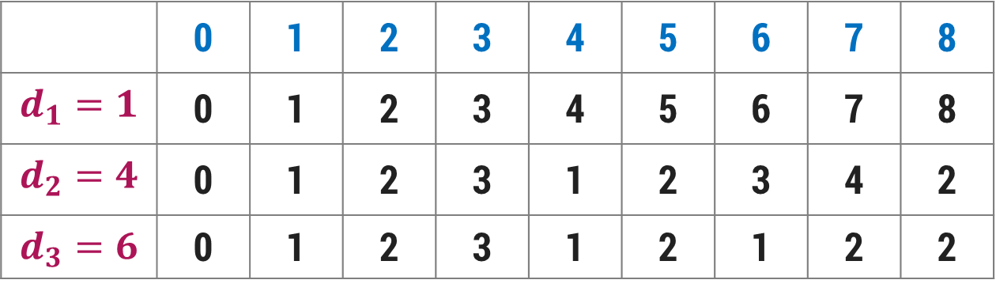
Making Change Problem
We can also find the coins to be included in the solution set as follows:
Start looking at c[3, 8] = c[2, 8] ⟹ So, not to include a coin with denomination 6.
Next go to c[2,8] ≠ c[1, 8] but c[2,8] = 1 + c[2,4]
So, include a coin with denomination 4
Now, got to c[2,4] ≠ c[1,4] but c[2,4] = 1+ c[2,0]
So, again include a coin with denomination 4
Go to c[2,0] = c[1,0] and stop.
 | 0 | 1 | 2 | 3 | 4 | 5 | 6 | 7 | 8
$$d_{1}=1$$ | 0 | 1 | 2 | 3 | 4 | 5 | 6 | 7 | 8
$$d_{2}=4$$ | 0 | 1 | 2 | 3 | 1 | 2 | 3 | 4 | 2
$$d_{3}=6$$ | 0 | 1 | 2 | 3 | 1 | 2 | 1 | 2 | 2
Solution contains 2 coins with denomination 4

Slide 28
0/1 Knapsack Problem

Slide 29
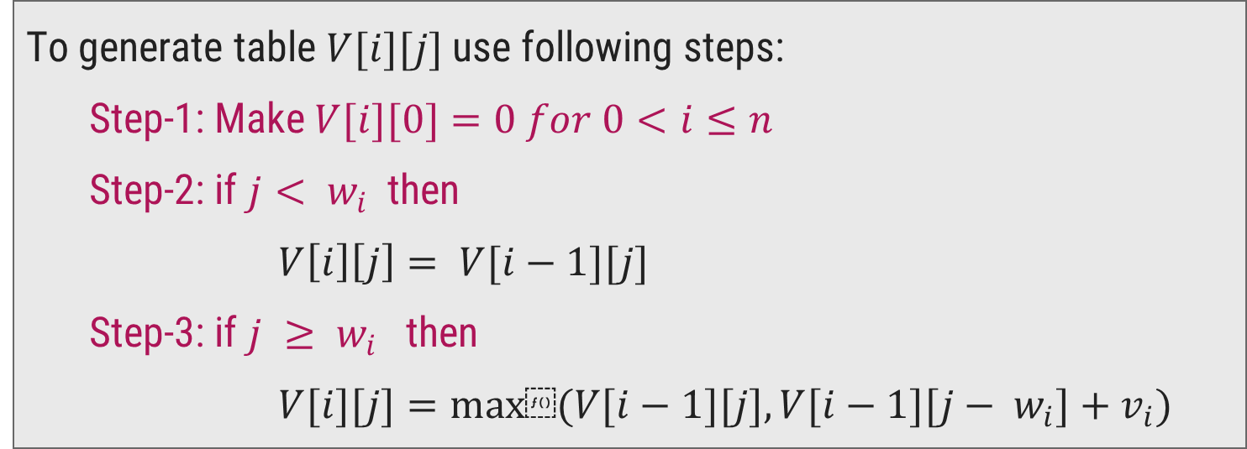
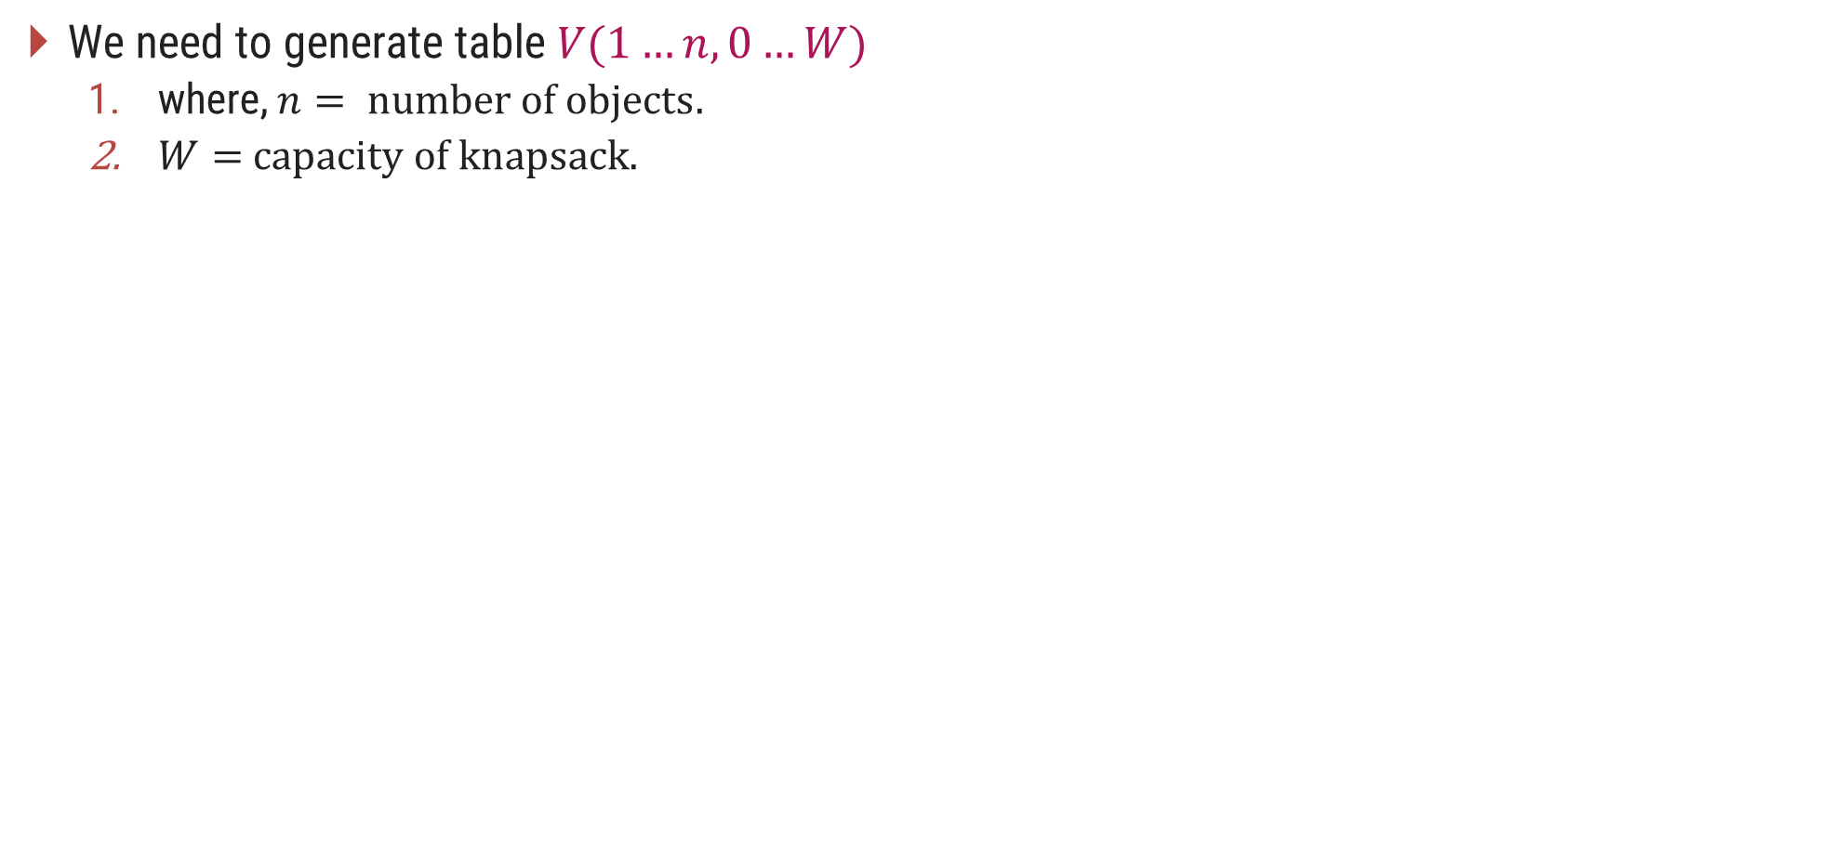
0/1 Knapsack Problem - Dynamic Programming Solution
We need to generate table $V(1…n,0…W)$
where, $n= number of objects.$
$W=$ $capacity of knapsack.$
To generate table $V[i][j]$use following steps:
Step-1: Make $V[i][0]=0 for 0<i≤n$
Step-2: if $j< w_{i}$then
$V\left[i\right]\left[j\right]= V[i−1][j]$
Step-3: if $j ≥ w_{i}$then
$V[i][j]=max⁡(V[i−1][j], V[i−1][j− w_{i}]+v_{i})$

Slide 30
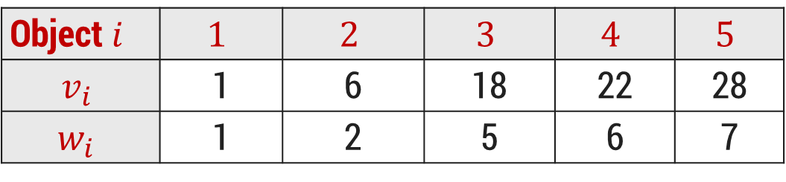
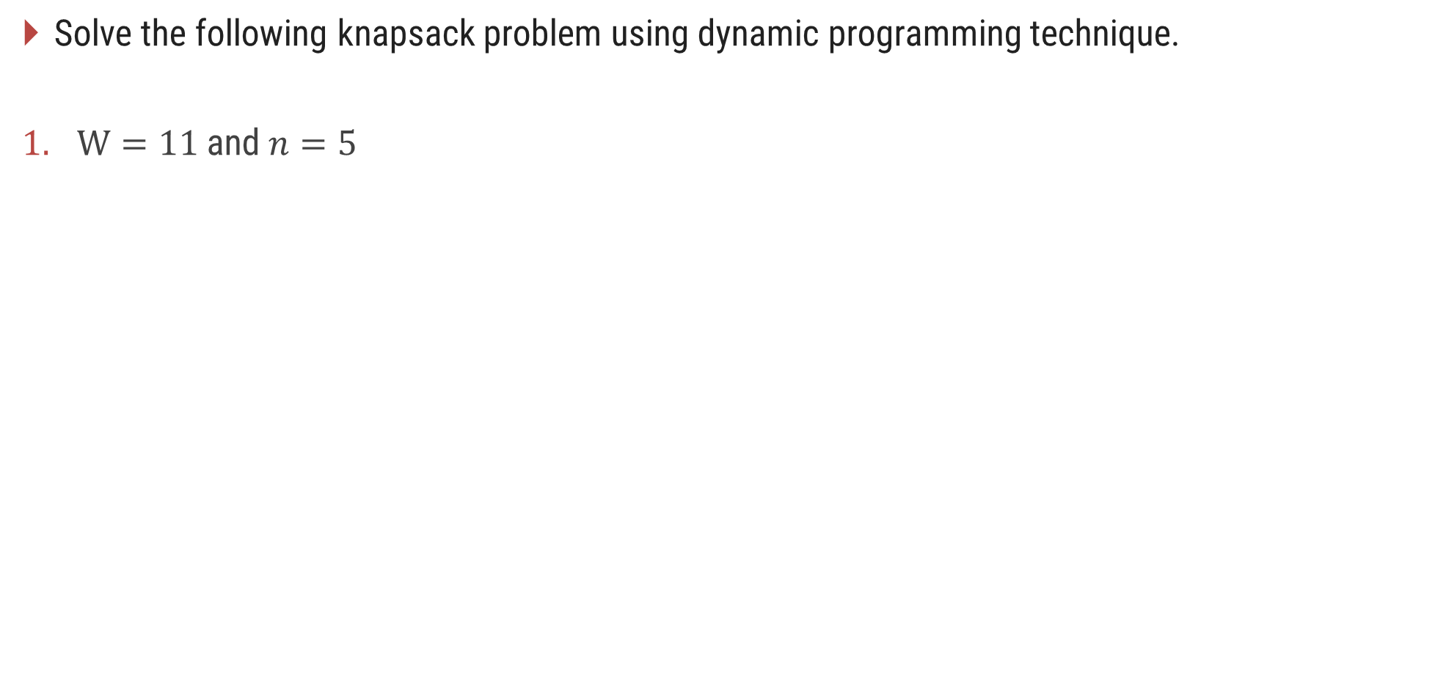
0/1 Knapsack Problem - Dynamic Programming Solution
Solve the following knapsack problem using dynamic programming technique.
$W=11$and $n=5$
Object$i$ | $$1$$ | $$2$$ | $$3$$ | $$4$$ | $$5$$
$$v_{i}$$ | 1 | 6 | 18 | 22 | 28
$$w_{i}$$ | 1 | 2 | 5 | 6 | 7

Slide 31

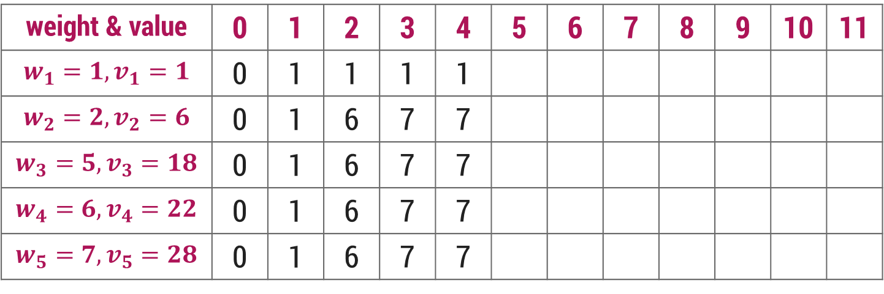
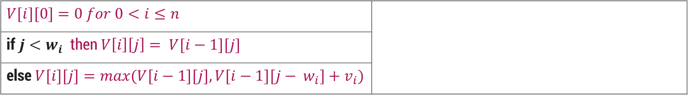
0/1 Knapsack Problem - Dynamic Programming Solution
$$V[i][0]=0 for 0<i≤n$$
if $j<w_{i}$then $V\left[i\right]\left[j\right]= V[i−1][j]$
else $V[i][j]=max⁡(V[i−1][j], V[i−1][j− w_{i}]+v_{i})$
$$j$$
Knapsack Capacity
weight & value | 0 | 1 | 2 | 3 | 4 | 5 | 6 | 7 | 8 | 9 | 10 | 11
$$w_{1}=1, v_{1}=1$$ | 0 | 1 | 1 | 1 | 1
$$w_{2}=2, v_{2}=6$$ | 0 | 1 | 6 | 7 | 7
$$w_{3}=5, v_{3}=18$$ | 0 | 1 | 6 | 7 | 7
$$w_{4}=6, v_{4}=22$$ | 0 | 1 | 6 | 7 | 7
$$w_{5}=7, v_{5}=28$$ | 0 | 1 | 6 | 7 | 7

Slide 32
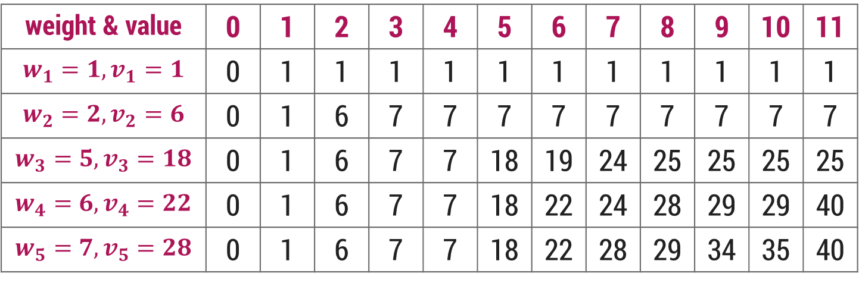
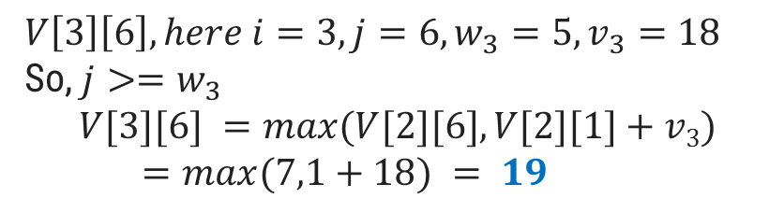
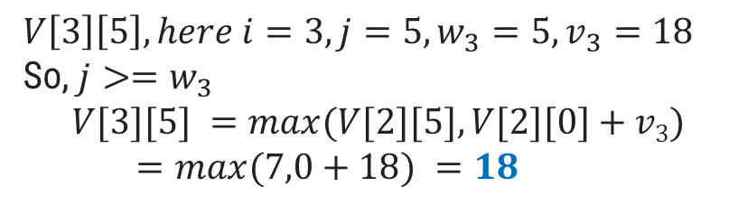
0/1 Knapsack Problem - Dynamic Programming Solution
$$V[i][0]=0 for 0<i≤n$$
if $j<w_{i}$then $V\left[i\right]\left[j\right]= V[i−1][j]$
else $V[i][j]=max⁡(V[i−1][j], V[i−1][j− w_{i}]+v_{i})$
$$V\left[3\right]\left[6\right], here i=3,j=6, w_{3}=5, v_{3}=18$$
So, $j>=w_{3}$
$$V[3][6] =max⁡(V[2][6],V[2][1]+v3)$$
$=max⁡(7,1+18) = 19$
$$V\left[3\right]\left[5\right], here i=3,j=5, w_{3}=5, v_{3}=18$$
So, $j>=w_{3}$
$$V[3][5] =max⁡(V[2][5],V[2][0]+v3)$$
$=max⁡(7,0+18) =18$
$$j$$
Knapsack Capacity
weight & value | 0 | 1 | 2 | 3 | 4 | 5 | 6 | 7 | 8 | 9 | 10 | 11
$$w_{1}=1, v_{1}=1$$ | 0 | 1 | 1 | 1 | 1 | 1 | 1 | 1 | 1 | 1 | 1 | 1
$$w_{2}=2, v_{2}=6$$ | 0 | 1 | 6 | 7 | 7 | 7 | 7 | 7 | 7 | 7 | 7 | 7
$$w_{3}=5, v_{3}=18$$ | 0 | 1 | 6 | 7 | 7 | 18 | 19 | 24 | 25 | 25 | 25 | 25
$$w_{4}=6, v_{4}=22$$ | 0 | 1 | 6 | 7 | 7 | 18 | 22 | 24 | 28 | 29 | 29 | 40
$$w_{5}=7, v_{5}=28$$ | 0 | 1 | 6 | 7 | 7 | 18 | 22 | 28 | 29 | 34 | 35 | 40

Slide 33
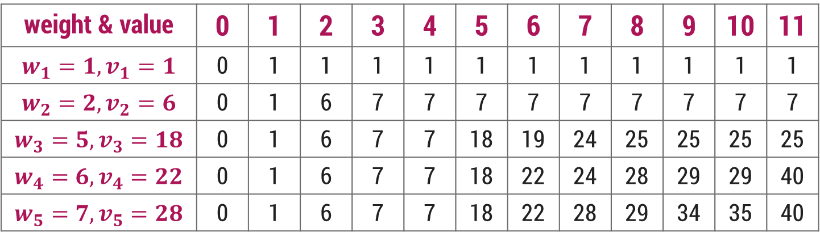
0/1 Knapsack Problem - Dynamic Programming Solution
We can also find the objects to be carried in the knapsack as follows,
Start looking at V[5, 11] = V[4, 11] ⟹ So not to include object 5
Next go to V[4, 11] ≠ V[3, 11] but V[4, 11] = V[3,11-w₄]+v₄ = V[3, 5]+22 So include object 4
Now go to V[3,5] ≠ V[2,5] but V[3,5] = V[2,5-w₃]+v₃ = V[2,0]+18 So include object 3
Now V[2,0] = V[1, 0] and V[1,0] = V[0,0] ⟹ So objects 2 and 1 are not included.
$$V[i][j]=max⁡(V[i−1][j], V[i−1][j− wi]+v_{i})$$
weight & value | 0 | 1 | 2 | 3 | 4 | 5 | 6 | 7 | 8 | 9 | 10 | 11
$$w_{1}=1, v_{1}=1$$ | 0 | 1 | 1 | 1 | 1 | 1 | 1 | 1 | 1 | 1 | 1 | 1
$$w_{2}=2, v_{2}=6$$ | 0 | 1 | 6 | 7 | 7 | 7 | 7 | 7 | 7 | 7 | 7 | 7
$$w_{3}=5, v_{3}=18$$ | 0 | 1 | 6 | 7 | 7 | 18 | 19 | 24 | 25 | 25 | 25 | 25
$$w_{4}=6, v_{4}=22$$ | 0 | 1 | 6 | 7 | 7 | 18 | 22 | 24 | 28 | 29 | 29 | 40
$$w_{5}=7, v_{5}=28$$ | 0 | 1 | 6 | 7 | 7 | 18 | 22 | 28 | 29 | 34 | 35 | 40

Slide 34
Assembly Line Scheduling

Slide 35
Introduction
Assembly line scheduling is a manufacturing problem.
In automobile industries, assembly lines are used to transfer parts from one station to another.
Manufacturing of large items like car, trucks etc. generally undergoes through multiple station, where each station is responsible for assembling particular part only.
Entire product will be ready after it goes through predefined n stations in sequence

Slide 36
Introduction
For example, manufacturing of car may be done in several stages like engine fitting, coloring, light fitting, fixing of controlling system, gates, seats and many other things.
Particular task is carried out at the station dedicated for that task only. Based on requirement, there may be more than one assembly line.
In case of two assembly lines, if load at station j of assembly line 1 is very high, then components are transferred to station j of assembly line 2, converse is also true. This helps to speed up the manufacturing process.
The time to transfer partial product from one station to next station on same assembly line is negligible.
During rush, factory manager may transfer partially completed auto from one assembly line to another, to complete the manufacturing as quick as possible. Some penalty of time t occurs when product is transferred from assembly 1 to 2 or 2 to 1.

Slide 37
Introduction
Determine which station should be selected from assembly line 1 and which to choose from assembly line 2 in order to minimize the total time to build the entire product.

Slide 38
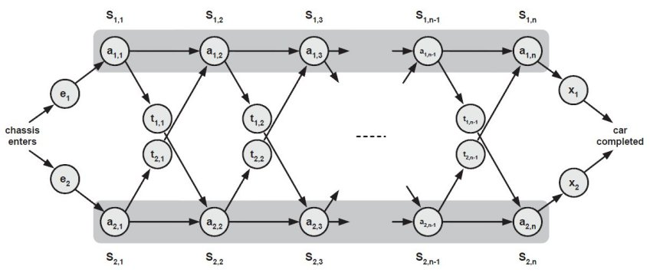
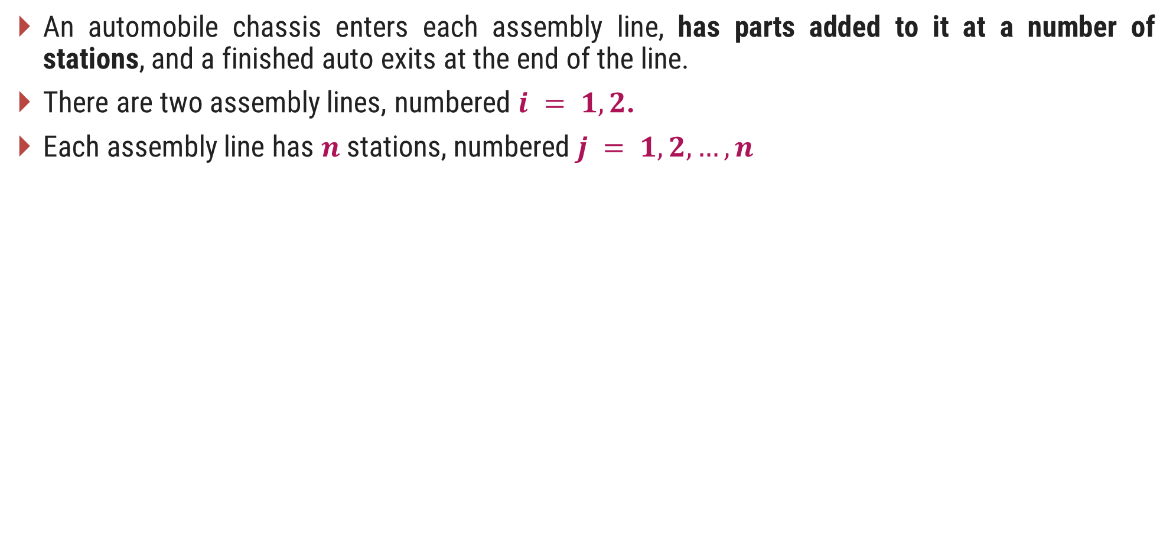
Introduction
An automobile chassis enters each assembly line, has parts added to it at a number of stations, and a finished auto exits at the end of the line.
There are two assembly lines, numbered $i = 1, 2$.
Each assembly line has $n$ stations, numbered $j = 1, 2,…,n$

Slide 39
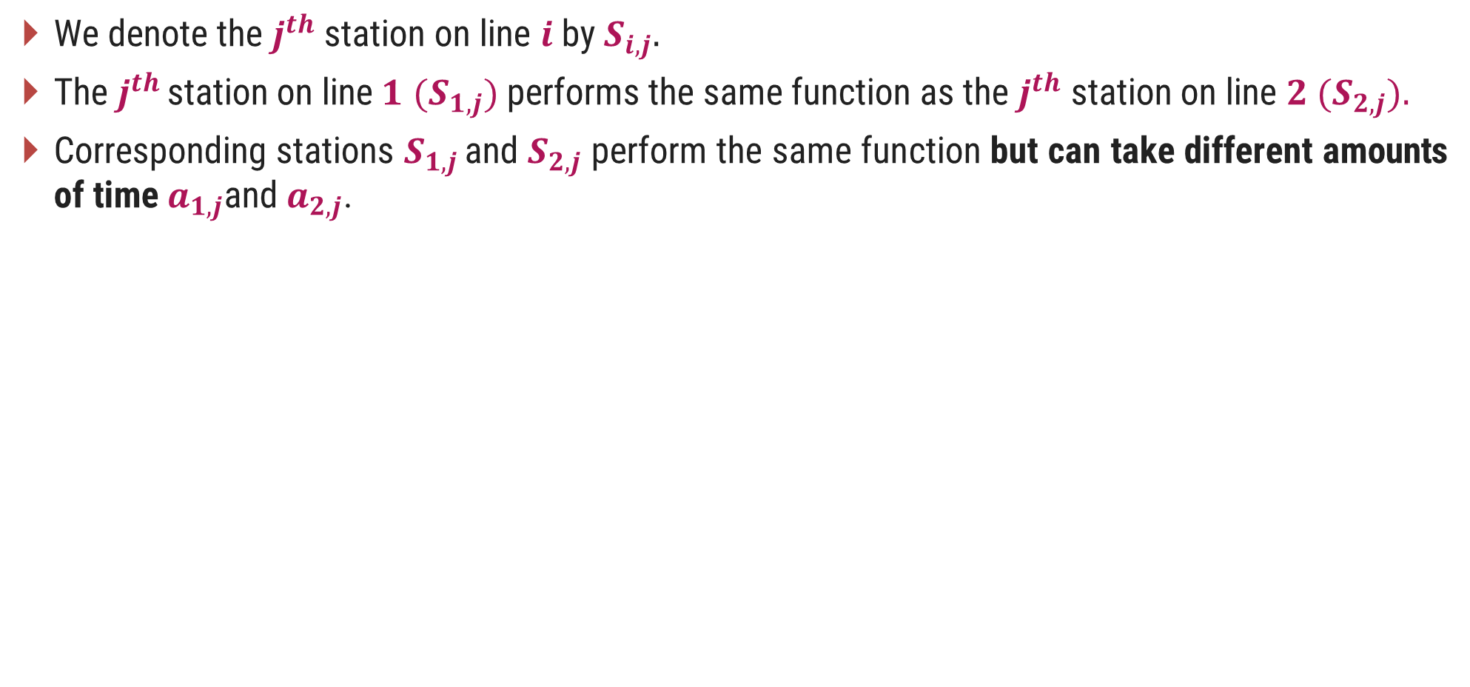
Introduction
We denote the $j^{th}$ station on line $i$by $S_{i,j}.$
The $j^{th}$ station on line$1$ $(S_{1,j})$performs the same function as the $j^{th}$ station on line $2 (S_{2,j}).$
Corresponding stations $S_{1,j}$ and $S_{2,j}$ perform the same function but can take different amounts of time $a_{1,j}$and $a_{2,j}$.

Slide 40
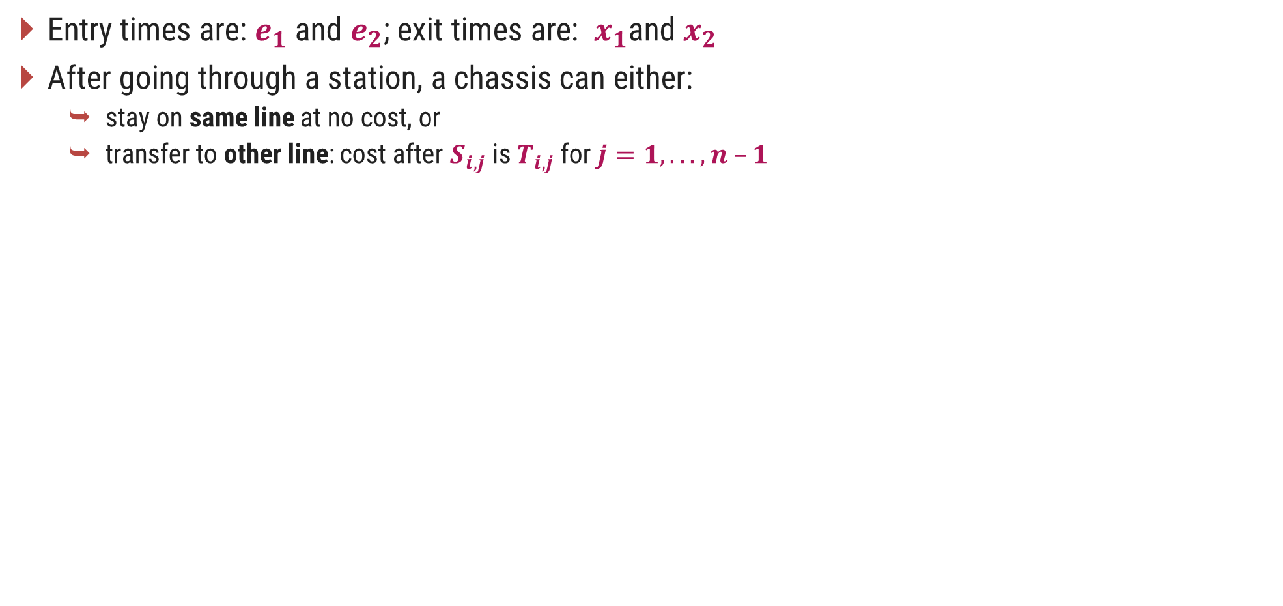
Introduction
Entry times are: $e_{1}$and $e_{2}$; exit times are: $x_{1}$and $x_{2}$
After going through a station, a chassis can either:
stay on same line at no cost, or
transfer to other line: cost after $S_{i,j}$ is $T_{i,j}$ for $j=1, . . . , n –1$

Slide 41
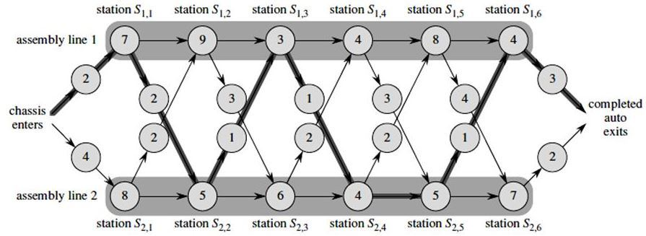
Assembly Line Scheduling - Example
Using dynamic programming technique, find the fastest time to get through the entire factory for the following:

Slide 42
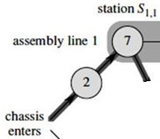
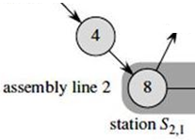
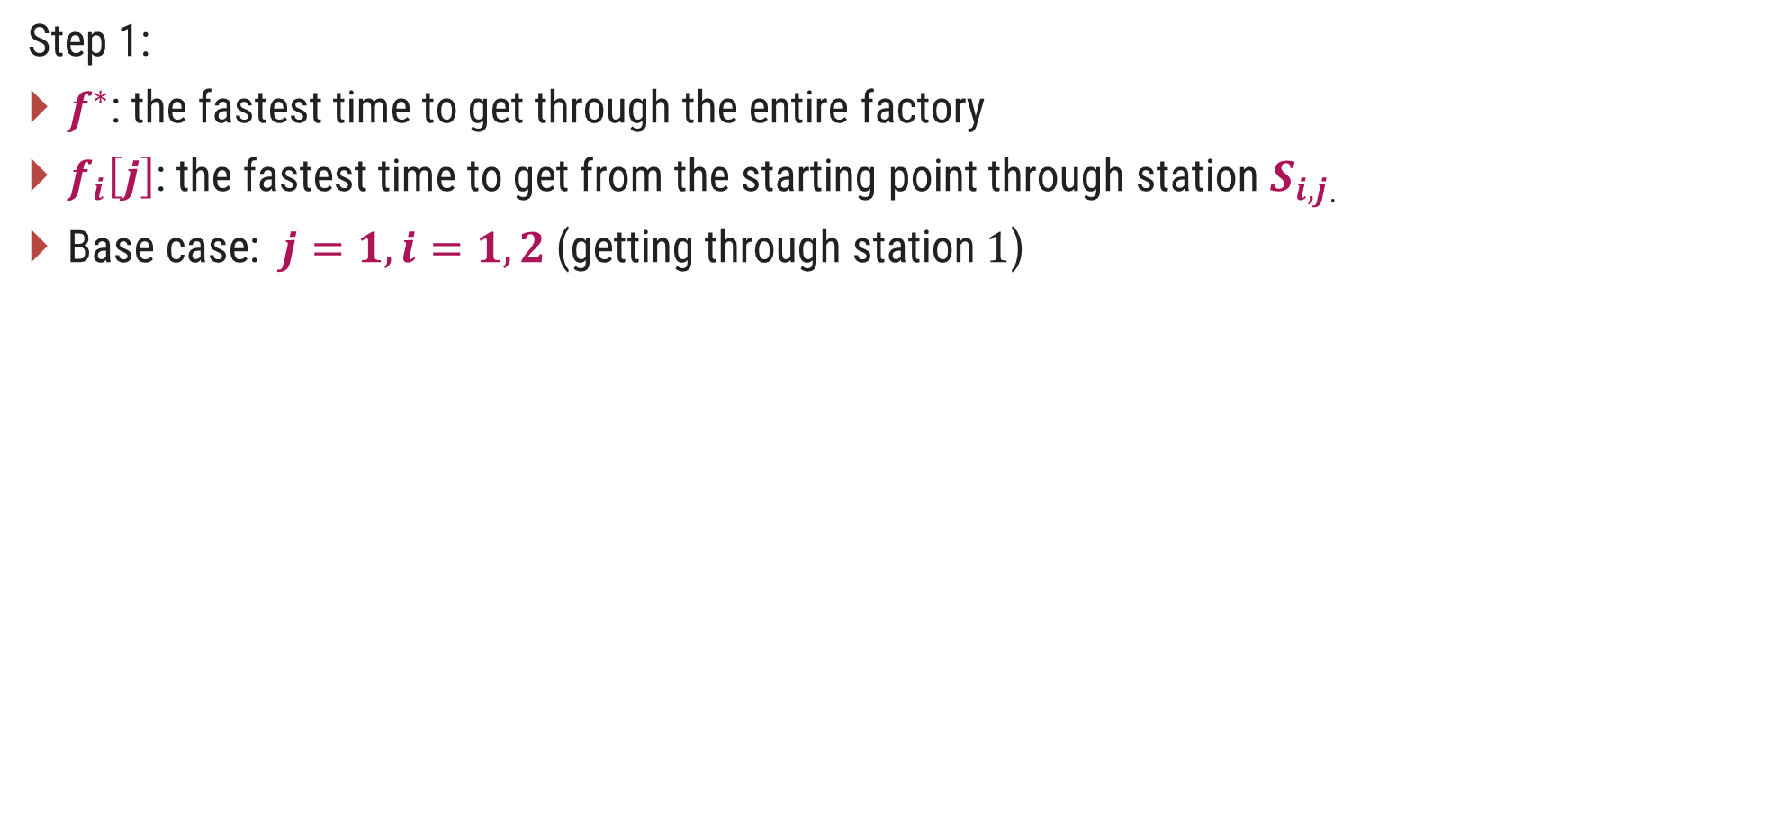
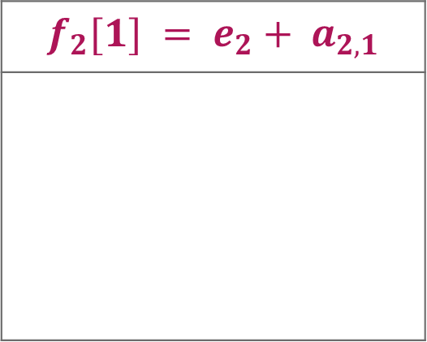
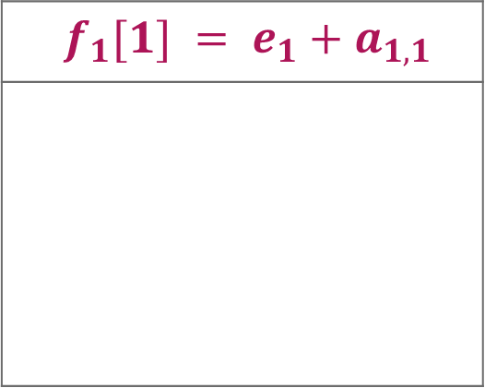
Assembly Line Scheduling - Example
Step 1:
$f^{∗}$: the fastest time to get through the entire factory
$f_{i}\left[j\right]$: the fastest time to get from the starting point through station $S_{i,j}$.
Base case: $j=1, i=1, 2$(getting through station $1$)
$f_{1}[1] = e_{1}+a_{1,1}$
$$f_{2}[1] = e_{2}+ a_{2,1}$$

Slide 43
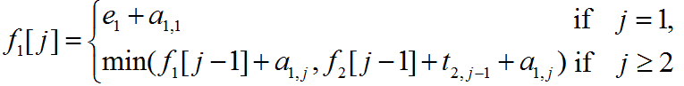
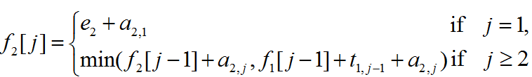
Assembly Line Scheduling – Dynamic Programming Solution
General Case: 𝑗 = 2, 3, …,𝑛 and 𝑖 = 1, 2 - Recursive solution

Slide 44
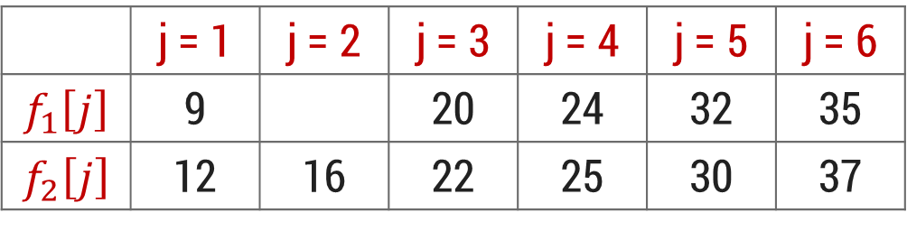
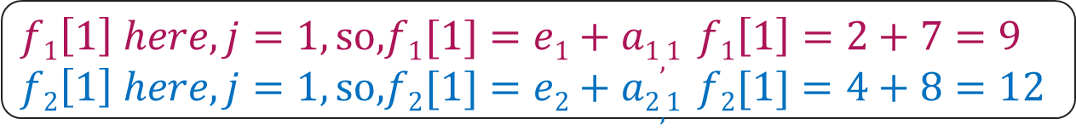
Assembly Line Scheduling – Dynamic Programming Solution
 | j = 1 | j = 2 | j = 3 | j = 4 | j = 5 | j = 6
$$f_{1}\left[j\right]$$ | 9 |  | 20 | 24 | 32 | 35
$$f_{2}\left[j\right]$$ | 12 | 16 | 22 | 25 | 30 | 37
$f1\left[1\right] here, j=1, so, f1[1]=e1+a1,1$ $f1\left[1\right]=2+7=9$
$f2\left[1\right] here, j=1, so, f2[1]=e2+a2,1$ $f2[1]=4+8=12$

Slide 45
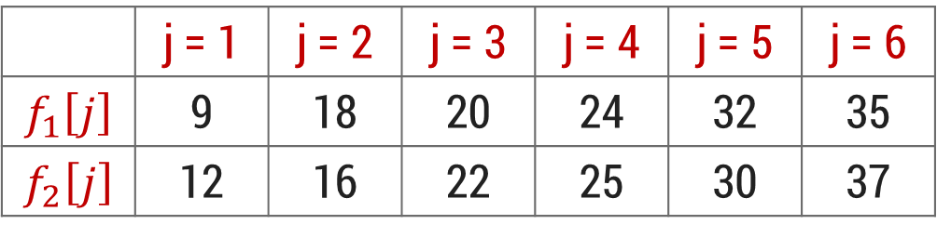
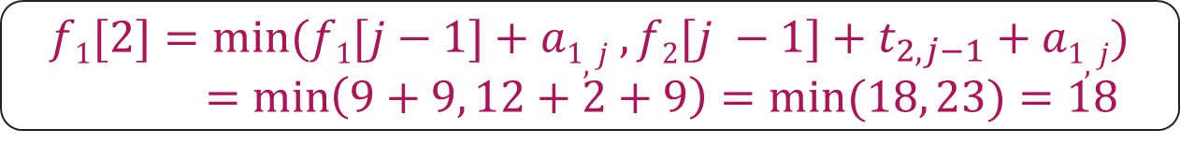
Assembly Line Scheduling – Dynamic Programming Solution
 | j = 1 | j = 2 | j = 3 | j = 4 | j = 5 | j = 6
$$f_{1}\left[j\right]$$ | 9 | 18 | 20 | 24 | 32 | 35
$$f_{2}\left[j\right]$$ | 12 | 16 | 22 | 25 | 30 | 37
$$f1[2]=min⁡(f1[j−1]+a1,j ,f2[j −1]+t_{2,j−1}+a1,j)$$
$$=\min\left(9+9, 12+2+9\right)=min⁡(18, 23)=18$$

Slide 46
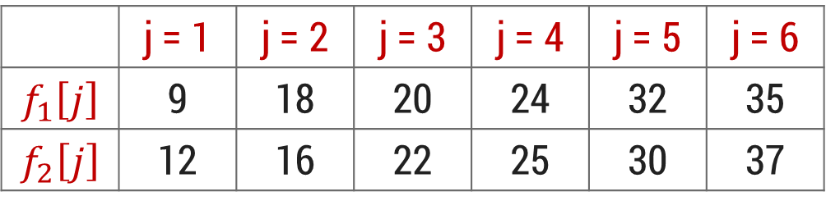
Assembly Line Scheduling – Dynamic Programming Solution
 | j = 1 | j = 2 | j = 3 | j = 4 | j = 5 | j = 6
$$f_{1}\left[j\right]$$ | 9 | 18 | 20 | 24 | 32 | 35
$$f_{2}\left[j\right]$$ | 12 | 16 | 22 | 25 | 30 | 37
$$Min (18+3, 16+1+3)=\min\left(21, 20\right)= 20$$

Slide 47
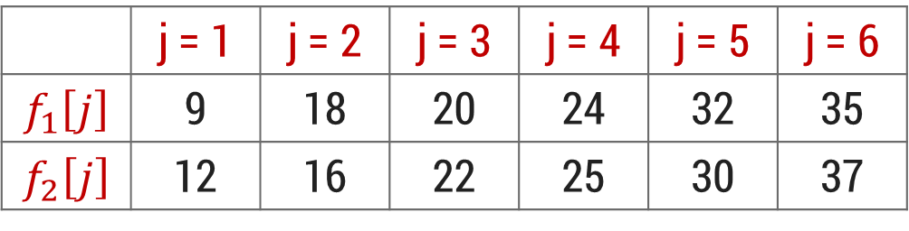
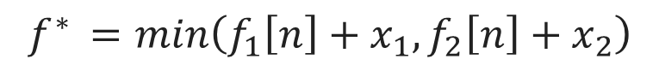
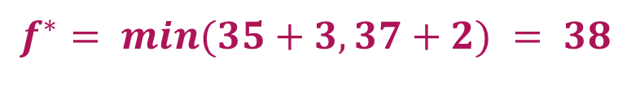
Assembly Line Scheduling – Dynamic Programming Solution
 | j = 1 | j = 2 | j = 3 | j = 4 | j = 5 | j = 6
$$f_{1}\left[j\right]$$ | 9 | 18 | 20 | 24 | 32 | 35
$$f_{2}\left[j\right]$$ | 12 | 16 | 22 | 25 | 30 | 37
$$f^{∗ }=min\left(f_{1}\left[n\right]+x_{1},f_{2}\left[n\right]+x_{2}\right)$$
$$f^{∗}= min⁡(35+3, 37+2) = 38$$

Slide 48
Longest Common Subsequence

Slide 49

Introduction
A subsequence is a sequence that appears in the same relative order, but not necessarily contiguous.
Given two sequences $X$ and $Y,$ we say that a sequence $Z$ is a common subsequence of $X$ and $Y$ if $Z$ is a subsequence of both $X$ and $Y$.
E.g., if $X = <A, B, C, B, D, A, B>$and $Y= <B, D, C, A, B, A>$ then $<B, C, A>$is a subsequence.
Use dynamic programming technique to find the longest common subsequence (LCS).

Slide 50


LCS – Optimal Sub-structure
We need to generate table $c(1..m, 1..n)$
where $m=$length of string $S1$ and $n=$ length of string $S2$.
To generate table $c[i][j]$use following steps:
Step-1: Make $c[i][0]=0$and $c[0][j]=0$
Step-2: if $x_{i}= y_{j}$then $c[i,j] ← c[i−1,j−1]+1$
Step-3: else $c[i,j] ← max(c[i−1,j]$, $c[i,j−1])$

Slide 51

LCS – Dynamic Programming Solution
$if x_{i}= y_{j} then c[i,j] ← c[i−1,j−1]+1$ else $c[i,j] ←$max($c[i−1,j]$, $c[i,j−1])$
 | $$y_{j}$$ | $$A$$ | $$B$$ | $$C$$ | $$B$$ | $$D$$ | $$A$$ | $$B$$
$$x_{i}$$ | 0 | 0 | 0 | 0 | 0 | 0 | 0 | 0
$$B$$ | 0 | 0 | 1 | 1 | 1 | 1 | 1 | 1
$$D$$ | 0 | 0 | 1 | 1 | 1 | 2 | 2 | 2
$$C$$ | 0 | 0 | 1 | 2 | 2 | 2 | 2 | 2
$$A$$ | 0 | 1 | 1 | 2 | 2 | 2 | 3 | 3
$$B$$ | 0 | 1 | 2 | 2 | 3 | 3 | 3 | 4
$$A$$ | 0 | 1 | 2 | 2 | 3 | 3 | 4 | 4

Slide 52
LCS – Dynamic Programming Solution
$if x_{i}= y_{j} then c[i,j] ← c[i−1,j−1]+1$ else $c[i,j] ←$max($c[i−1,j]$, $c[i,j−1])$
 | $$y_{j}$$ | $$A$$ | $$B$$ | $$C$$ | $$B$$ | $$D$$ | $$A$$ | $$B$$
$$x_{i}$$ | 0 | 0 | 0 | 0 | 0 | 0 | 0 | 0
$$B$$ | 0 | 0 | 1 | 1 | 1 | 1 | 1 | 1
$$D$$ | 0 | 0 | 1 | 1 | 1 | 2 | 2 | 2
$$C$$ | 0 | 0 | 1 | 2 | 2 | 2 | 2 | 2
$$A$$ | 0 | 1 | 1 | 2 | 2 | 2 | 3 | 3
$$B$$ | 0 | 1 | 2 | 2 | 3 | 3 | 3 | 4
$$A$$ | 0 | 1 | 2 | 2 | 3 | 3 | 4 | 4

Slide 53
LCS – Dynamic Programming Solution
$if x_{i}= y_{j} then c[i,j] ← c[i−1,j−1]+1$ else $c[i,j] ←$max($c[i−1,j]$, $c[i,j−1])$
 | $$y_{j}$$ | $$A$$ | $$B$$ | $$C$$ | $$B$$ | $$D$$ | $$A$$ | $$B$$
$$x_{i}$$ | 0 | 0 | 0 | 0 | 0 | 0 | 0 | 0
$$B$$ | 0 | 0 | 1 | 1 | 1 | 1 | 1 | 1
$$D$$ | 0 | 0 | 1 | 1 | 1 | 2 | 2 | 2
$$C$$ | 0 | 0 | 1 | 2 | 2 | 2 | 2 | 2
$$A$$ | 0 | 1 | 1 | 2 | 2 | 2 | 3 | 3
$$B$$ | 0 | 1 | 2 | 2 | 3 | 3 | 3 | 4
$$A$$ | 0 | 1 | 2 | 2 | 3 | 3 | 4 | 4

Slide 54
LCS – Dynamic Programming Solution
$X= < A, B, C, B, D, A, B>$and $Y= <B, D, C, A, B, A>$ and LCS = $<B, D, A, B>$
 | $$y_{j}$$ | $$A$$ | $$B$$ | $$C$$ | $$B$$ | $$D$$ | $$A$$ | $$B$$
$$x_{i}$$ | 0 | 0 | 0 | 0 | 0 | 0 | 0 | 0
$$B$$ | 0 | 0 | 1 | 1 | 1 | 1 | 1 | 1
$$D$$ | 0 | 0 | 1 | 1 | 1 | 2 | 2 | 2
$$C$$ | 0 | 0 | 1 | 2 | 2 | 2 | 2 | 2
$$A$$ | 0 | 1 | 1 | 2 | 2 | 2 | 3 | 3
$$B$$ | 0 | 1 | 2 | 2 | 3 | 3 | 3 | 4
$$A$$ | 0 | 1 | 2 | 2 | 3 | 3 | 4 | 4

Slide 55
All Pair Shortest Path – Floyd’s Algorithm

Slide 56

Introduction
Given a directed, connected weighted graph $G(V, E),$for each edge $⟨u, v⟩∈E$, a weight $w(u, v)$is associated with each edge.
The all pairs of shortest paths problem is to find a shortest path from $u$ to $v$ for every pair of vertices $u$ and $v$ in $V$.
Floyd’s algorithm is used to find all pair shortest path problem from a given weighted graph.
As a result of this algorithm, it will generate a matrix, which will represent the minimum distance from any node to all other nodes in the graph.
At first, the output matrix is same as given cost matrix of the graph.
As the algorithm proceeds, the output matrix will be updated with each vertex $k$ as an intermediate vertex.
The time complexity of this algorithm is $O(n^{3})$, where $n$ is the number of vertices in the graph.

Slide 57



Floyd Algorithm - Example
Step: 2
Calculate the distance between each node with node 1 as an intermediate node.
1
15
4
30
5
5
50
5
15
1 | 2 | 3 | 4
D₁ = $\left(\begin{matrix}0 & 5 & ∞ & ∞ \\ 50 & 0 & 15 & 5 \\ 30 & ∞ & 0 & 15 \\ 15 & ∞ & 5 & 0\end{matrix}\right)$
2
3
1
2
3
4
15
Step: 1
Initialization
1 | 2 | 3 | 4
D₀ = $\left(\begin{matrix}0 & 5 & ∞ & ∞ \\ 50 & 0 & 15 & 5 \\ 30 & ∞ & 0 & 15 \\ 15 & ∞ & 5 & 0\end{matrix}\right)$
1
2
3
4
For node 2
$$2→1→3=∞$$ | $$2→3=15$$
$$2→1→4=∞$$ | $$2→4=5$$
No change

Slide 58



Floyd Algorithm - Example
Step: 2
Calculate the distance between each node with node 1 as an intermediate node.
1
15
4
30
5
5
50
5
15
1 | 2 | 3 | 4
D₁ = $\left(\begin{matrix}0 & 5 & ∞ & ∞ \\ 50 & 0 & 15 & 5 \\ 30 & ∞ & 0 & 15 \\ 15 & ∞ & 5 & 0\end{matrix}\right)$
2
3
1
2
3
4
15
$$35$$
Step: 1
Initialization
1 | 2 | 3 | 4
D₀ = $\left(\begin{matrix}0 & 5 & ∞ & ∞ \\ 50 & 0 & 15 & 5 \\ 30 & ∞ & 0 & 15 \\ 15 & ∞ & 5 & 0\end{matrix}\right)$
1
2
3
4
For node 3
$$3→1→2=35$$ | $$3→2=∞$$
$$3→1→4=∞$$ | $$3→4=15$$

Slide 59



Floyd Algorithm - Example
Step: 2
Calculate the distance between each node with node 1 as an intermediate node.
1
15
4
30
5
5
50
5
15
1 | 2 | 3 | 4
D₁ = $\left(\begin{matrix}0 & 5 & ∞ & ∞ \\ 50 & 0 & 15 & 5 \\ 30 & 35 & 0 & 15 \\ 15 & ∞ & 5 & 0\end{matrix}\right)$
2
3
1
2
3
4
15
Step: 1
Initialization
$$20$$
1 | 2 | 3 | 4
D₀ = $\left(\begin{matrix}0 & 5 & ∞ & ∞ \\ 50 & 0 & 15 & 5 \\ 30 & ∞ & 0 & 15 \\ 15 & ∞ & 5 & 0\end{matrix}\right)$
1
2
3
4
For node 4
$$4→1→2=20$$ | $$4→2=∞$$
$$4→1→3=∞$$ | $$4→3=5$$

Slide 60




Floyd Algorithm - Example
Step: 3
Calculate the distance between each node with node 2 as an intermediate node.
1
15
4
30
5
5
50
5
15
1 | 2 | 3 | 4
D₂ = $\left(\begin{matrix}0 & 5 & ∞ & ∞ \\ 50 & 0 & 15 & 5 \\ 30 & 35 & 0 & 15 \\ 15 & 20 & 5 & 0\end{matrix}\right)$
2
3
1
2
3
4
$$20$$
$$10$$
15
Step: 1
Initialization
1 | 2 | 3 | 4
D₀ = $\left(\begin{matrix}0 & 5 & ∞ & ∞ \\ 50 & 0 & 15 & 5 \\ 30 & ∞ & 0 & 15 \\ 15 & ∞ & 5 & 0\end{matrix}\right)$
1
2
3
4
For node 1
$$1→2→3=20$$ | $$1→3=∞$$
$$1→2→4=10$$ | $$1→4=∞$$
No change for Node 3 & 4

Slide 61


Floyd Algorithm - Example
Step: 4
Calculate the distance between each node with node 3 as an intermediate node.
1
15
4
30
5
5
50
5
15
1 | 2 | 3 | 4
D₃ = $\left(\begin{matrix}0 & 5 & 20 & 10 \\ 50 & 0 & 15 & 5 \\ 30 & 35 & 0 & 15 \\ 15 & 20 & 5 & 0\end{matrix}\right)$
2
3
1
2
3
4
15
Step: 1
Initialization
1 | 2 | 3 | 4
D₀ = $\left(\begin{matrix}0 & 5 & ∞ & ∞ \\ 50 & 0 & 15 & 5 \\ 30 & ∞ & 0 & 15 \\ 15 & ∞ & 5 & 0\end{matrix}\right)$
1
2
3
4
For node 1
$$1→3→2=55$$ | $$1→2=5$$
$$1→3→4=35$$ | $$1→4=10$$
No change

Slide 62


Floyd Algorithm - Example
Step: 4
Calculate the distance between each node with node 3 as an intermediate node.
1
15
4
30
5
5
50
5
15
1 | 2 | 3 | 4
D₃ = $\left(\begin{matrix}0 & 5 & 20 & 10 \\ 50 & 0 & 15 & 5 \\ 30 & 35 & 0 & 15 \\ 15 & 20 & 5 & 0\end{matrix}\right)$
2
3
1
2
3
4
15
$$45$$
Step: 1
Initialization
1 | 2 | 3 | 4
D₀ = $\left(\begin{matrix}0 & 5 & ∞ & ∞ \\ 50 & 0 & 15 & 5 \\ 30 & ∞ & 0 & 15 \\ 15 & ∞ & 5 & 0\end{matrix}\right)$
1
2
3
4
For node 2
$$2→3→1=45$$ | $$2→1=50$$
$$2→3→4=30$$ | $$2→4=5$$
No change for Node 4

Slide 63



Floyd Algorithm - Example
Step: 5
Calculate the distance between each node with node 4 as an intermediate node.
1
15
4
30
5
5
50
5
15
1 | 2 | 3 | 4
D₄ = $\left(\begin{matrix}0 & 5 & 20 & 10 \\ 45 & 0 & 15 & 5 \\ 30 & 35 & 0 & 15 \\ 15 & 20 & 5 & 0\end{matrix}\right)$
2
3
1
2
3
4
$$15$$
15
Step: 1
Initialization
1 | 2 | 3 | 4
D₀ = $\left(\begin{matrix}0 & 5 & ∞ & ∞ \\ 50 & 0 & 15 & 5 \\ 30 & ∞ & 0 & 15 \\ 15 & ∞ & 5 & 0\end{matrix}\right)$
1
2
3
4
For node 1
$$1→4→2=30$$ | $$1→2=5$$
$$1→4→3=15$$ | $$1→3=20$$

Slide 64




Floyd Algorithm - Example
Step: 5
Calculate the distance between each node with node 4 as an intermediate node.
1
15
4
30
5
5
50
5
15
1 | 2 | 3 | 4
D₄ = $\left(\begin{matrix}0 & 5 & 15 & 10 \\ 45 & 0 & 15 & 5 \\ 30 & 35 & 0 & 15 \\ 15 & 20 & 5 & 0\end{matrix}\right)$
2
3
1
2
3
4
15
$$20$$
$$10$$
Step: 1
Initialization
1 | 2 | 3 | 4
D₀ = $\left(\begin{matrix}0 & 5 & ∞ & ∞ \\ 50 & 0 & 15 & 5 \\ 30 & ∞ & 0 & 15 \\ 15 & ∞ & 5 & 0\end{matrix}\right)$
1
2
3
4
For node 2
$$2→4→1=20$$ | $$2→1=45$$
$$2→4→3=10$$ | $$2→3=15$$
No change for Node 3

Slide 65

Floyd Algorithm - Example
Step: 5
Calculate the distance between each node with node 4 as an intermediate node.
1
15
4
30
5
5
50
5
15
1 | 2 | 3 | 4
D₄ = $\left(\begin{matrix}0 & 5 & 15 & 10 \\ 20 & 0 & 10 & 5 \\ 30 & 35 & 0 & 15 \\ 15 & 20 & 5 & 0\end{matrix}\right)$
2
3
1
2
3
4
15
Step: 1
Initialization
1 | 2 | 3 | 4
D₀ = $\left(\begin{matrix}0 & 5 & ∞ & ∞ \\ 50 & 0 & 15 & 5 \\ 30 & ∞ & 0 & 15 \\ 15 & ∞ & 5 & 0\end{matrix}\right)$
1
2
3
4
Final Solution

Slide 66
Floyd’s Algorithm
function Floyd(L[1..n, 1..n]):array [1..n, 1..n]
array D[1..n, 1..n]
D ← L
for k ← 1 to n do
for i ← 1 to n do
for j ← 1 to n do
D[i,j] ← min(D[i,j], D[i,k]+ D[k,j])
return D

Slide 67
Chain Matrix Multiplication

Slide 68




Introduction
$A=\left[\begin{matrix}A_{11} & A_{12} & A_{13} \\ A_{21} & A_{22} & A_{23}\end{matrix}\right]$ and $B=\left[\begin{matrix}B_{11} & B_{12} \\ B_{21} & B_{22} \\ B_{31} & B_{32}\end{matrix}\right]$
$$C_{11}=A_{11}∙B_{11}+A_{12}∙B_{21}+A_{13}∙B_{31}$$
$$C_{12}=A_{11}∙B_{12}+A_{12}∙B_{22}+A_{13}∙B_{32}$$
$$C_{21}=A_{21}∙B_{11}+A_{22}∙B_{21}+A_{23}∙B_{31}$$
$$C_{22}=A_{21}∙B_{12}+A_{22}∙B_{22}+A_{23}∙B_{32}$$
Let matrix $A (p× q)$and matrix $B (q × r)$are two given matrices for multiplication.
The resultant matrix $C=A ∙B$
So,
Suppose, matrix $A (2×3)$and matrix $B (3×2)$are given.
The product $C=A ∙B$and the dimension of matrix $C$ is $2×2$
The total number of scalar multiplications required will be,
$C_{ij}=\sum_{k=1}^{q}{a_{ik}b_{kj}}$ Where, $1≤i≤p$and $1≤j≤r$
$$p∗q∗r=2∗3∗2=12$$

Slide 69




Matrix Chain Multiplication
Now, we want to calculate the product of more than two matrices. Matrix multiplication is associative.
The product of four matrices $A(13×5), B(5×89), C(89×3), D(3×34)$ can be fully parenthesized in $5$ distinct ways.
1 | $$((AB)C)D$$ | $$10582$$
$$R1=A(13×5)∙B(5×89)$$ | $$13∗5∗89=5785$$
Dimension of $R1 (13×89)$
$$R2=R1(13×89) . C(89×3)$$ | $$13∗89∗3=3471$$
Dimension of $R2 (13×3)$
$$R3=R2(13×3) . D(3×34)$$ | $$13∗3∗34=1326$$
Dimension of $R3 (13×34)$
$$10582$$

Slide 70



Matrix Chain Multiplication
Now, we want to calculate the product of more than two matrices. Matrix multiplication is associative.
The product of four matrices $A(13×5), B(5×89), C(89×3), D(3×34)$ can be fully parenthesized in $5$ distinct ways.
1 | $$((AB)C)D$$ | $$10582$$
2 | $$(AB)(CD)$$ | $$54201$$
3 | $$(A(BC))D$$ | $$2856$$
4 | $$A((BC)D)$$ | $$4055$$
5 | $$A(B(CD))$$ | $$26418$$
$$R1=A(13×5)∙B(5×89)$$ | $$13∗5∗89=5785$$
Dimension of $R1 (13×89)$
$$R2=C(89×3) . D(3×34)$$ | $$89∗3∗34=9078$$
Dimension of $R2 (89×34)$
$$R3=R1(13×89) . R2(89×34)$$ | $$13∗89∗34=39338$$
Dimension of $R3 (13×34)$
$$54201$$

Slide 71


Matrix Chain Multiplication using Dynamic Programming
Matrix table $M[i][j]$stores the cost of multiplications.
To generate $M[i][j]$use following steps:
Step-1: if $i=j$then $M[i][j]=0$
Step-2: if $j=i+1$then $M[i][j] = P_{i−1}∙P_{i}∙P_{i+1}$
Step-3: if $i<j$then
$$M[i][j]= min⁡(M[i][k]+M[k+1][j]+P_{i−1}∙P_{k}∙P_{j}) with i≤k<j$$

Slide 72


Matrix Chain Multiplication using Dynamic Programming
Here dimensions are, $P_{0}=5,P_{1}=4,P_{2}=6,P_{3}=2,P_{4}=7.$
There would be $4$matrices $A(5×4$),$B(4×6), C(6×2)$and $D(2×7).$
Step-2: if $j=i+1$then $M[i][j] = P_{i−1}∙P_{i}∙P_{i+1}$
Step-1: if $i=j$then $M[i][j]=0$
So, $M[1][1] = M[2][2] = M[3][3] = M[4][4] = 0$
$$M[1][2] = P_{0} ∗P_{1}∗P_{2}= 5 ∗ 4 ∗ 6 = 120$$
$$M[2][3] = P_{1} ∗P_{2}∗P_{3}=4 ∗6 ∗2 =48$$
$$M[3][4] = P_{2} ∗P_{3}∗P_{4}=6 ∗2 ∗7 =84$$
 | 1 | 2 | 3 | 4
1 | 0 | 120
2 | -- | 0 | 48
3 | -- | -- | 0 | 84
4 | -- | -- | -- | 0

Slide 73



Matrix Chain Multiplication using Dynamic Programming
Here dimensions are,
$P_{0}=5,P_{1}=4,P_{2}=6,P_{3}=2,P_{4}=7.$
$$M\left[1\right]\left[3\right], here i<j$$
$$for i=1,j=3 and k=1 or 2$$
$$because i≤k≤ j−1$$
$$For k=1$$
$$M[1][3]=M[1][1]+M[2][3]+P0∗P1∗P3$$
$$=0+48+5∗4∗2$$
$$M[1][3]=88$$
$$For k=2$$
$$M[1][3]=M[1][2]+M[3][3]+P0∗P2∗P3$$
$$=120+0+5∗6∗2$$
$$M[1][3]=180$$
step 3:
$$M\left[i\right]\left[j\right]=min\left(M\left[i\right]\left[k\right]+M\left[k+1\right]\left[j\right]+P_{i−1}∙P_{k}∙P_{j}\right)$$
$$with i≤k<j$$
 | 1 | 2 | 3 | 4
1 | 0 | 120 | 88
2 | -- | 0 | 48
3 | -- | -- | 0 | 84
4 | -- | -- | -- | 0

Slide 74

Matrix Chain Multiplication using Dynamic Programming
Here dimensions are,
$P_{0}=5,P_{1}=4,P_{2}=6,P_{3}=2,P_{4}=7.$
$$M\left[2\right]\left[4\right], here i<j$$
$$for i=2,j=4 and k=2 or 3$$
$$because i≤k≤ j−1$$
$$For k=2$$
$$M[2][4]=M[2][2]+M[3][4]+P1∗P2∗P4$$
$$=0+84+4∗6∗7$$
$$M[1][3]=252$$
$$For k=3$$
$$M[2][4]=M[2][3]+M[4][4]+P1∗P3∗P4$$
$$=48+0+4∗2∗7$$
$$M[2][4]=104$$
step 3:
$$M\left[i\right]\left[j\right]=min\left(M\left[i\right]\left[k\right]+M\left[k+1\right]\left[j\right]+P_{i−1}∙P_{k}∙P_{j}\right)$$
$$with i≤k<j$$
 | 1 | 2 | 3 | 4
1 | 0 | 120 | 88
2 | -- | 0 | 48 | 104
3 | -- | -- | 0 | 84
4 | -- | -- | -- | 0

Slide 75

Matrix Chain Multiplication using Dynamic Programming
Here dimensions are,
$P_{0}=5,P_{1}=4,P_{2}=6,P_{3}=2,P_{4}=7.$
$$M\left[1\right]\left[4\right], here i < j$$
$$for i=1,j=4 and k=1 or 2 or 3$$
$$because i ≤ k ≤ j−1$$
$$For k=1$$
$$M[1][4]=M[1][1]+M[2][4]+P0∗P1∗P4$$
$$= 0+104+5∗4∗7 = 244$$
$$For k=2$$
$$M[1][4]=M[1][2]+M[3][4]+P0∗P2∗P4$$
$$= 120+84+5∗6∗7 = 414$$
$$For k=3$$
$$M[1][4]=M[1][3]+M[4][4]+P0∗P3∗P4$$
$$= 88+0+5∗2∗7=158$$
step 3:
$$M\left[i\right]\left[j\right]=min\left(M\left[i\right]\left[k\right]+M\left[k+1\right]\left[j\right]+P_{i−1}∙P_{k}∙P_{j}\right)$$
$$with i≤k<j$$
 | 1 | 2 | 3 | 4
1 | 0 | 120 | 88 | 158
2 | -- | 0 | 48 | 104
3 | -- | -- | 0 | 84
4 | -- | -- | -- | 0

Slide 76
Matrix Chain Multiplication using Dynamic Programming
How to parenthesize matrices?
$$M\left[1\right]\left[4\right], here i < j$$
$$for i=1,j=4 and k=1 or 2 or 3$$
$$because i ≤ k ≤ j−1$$
$$For k=1$$
$$M[1][4]=M[1][1]+M[2][4]+P0∗P1∗P4$$
$$= 0+104+5∗4∗7 = 244$$
$$For k=2$$
$$M[1][4]=M[1][2]+M[3][4]+P0∗P2∗P4$$
$$= 120+84+5∗6∗7 = 414$$
$$For k=3$$
$$M[1][4]=M[1][3]+M[4][4]+P0∗P3∗P4$$
$$= 88+0+5∗2∗7=158$$
A B C D
 | 1 | 2 | 3 | 4
1 | 0 | 120 | 88 | 158
2 | -- | 0 | 48 | 104
3 | -- | -- | 0 | 84
4 | -- | -- | -- | 0

Slide 77
Matrix Chain Multiplication using Dynamic Programming
How to parenthesize matrices?
$$M\left[1\right]\left[3\right], here i<j$$
$$for i=1,j=3 and k=1 or 2$$
$$because i≤k≤ j−1$$
$$For k=1$$
$$M[1][3]=M[1][1]+M[2][3]+P0∗P1∗P3$$
$$=0+48+5∗4∗2$$
$$M[1][3]=88$$
$$For k=2$$
$$M[1][3]=M[1][2]+M[3][3]+P0∗P2∗P3$$
$$=120+0+5∗6∗2$$
$$M[1][3]=180$$
A B C D
 | 1 | 2 | 3 | 4
1 | 0 | 120 | 88 | 158
2 | -- | 0 | 48 | 104
3 | -- | -- | 0 | 84
4 | -- | -- | -- | 0

Slide 78

Matrix Chain Multiplication using Dynamic Programming
Here dimensions are, $P_{0}=5,P_{1}=4,P_{2}=6,P_{3}=2,P_{4}=7.$
There would be $4$matrices $A(5×4$),$B(4×6), C(6×2)$and $D(2×7).$
A B C D
$$R1=B.C$$ | $$4 ∗6∗2=48$$
$$R2=A.R1$$ | $$5 ∗4∗2=40$$
$$R3=R1.D$$ | $$5 ∗2∗7=70$$
158

Slide 79
Thank You!

